Slide 1
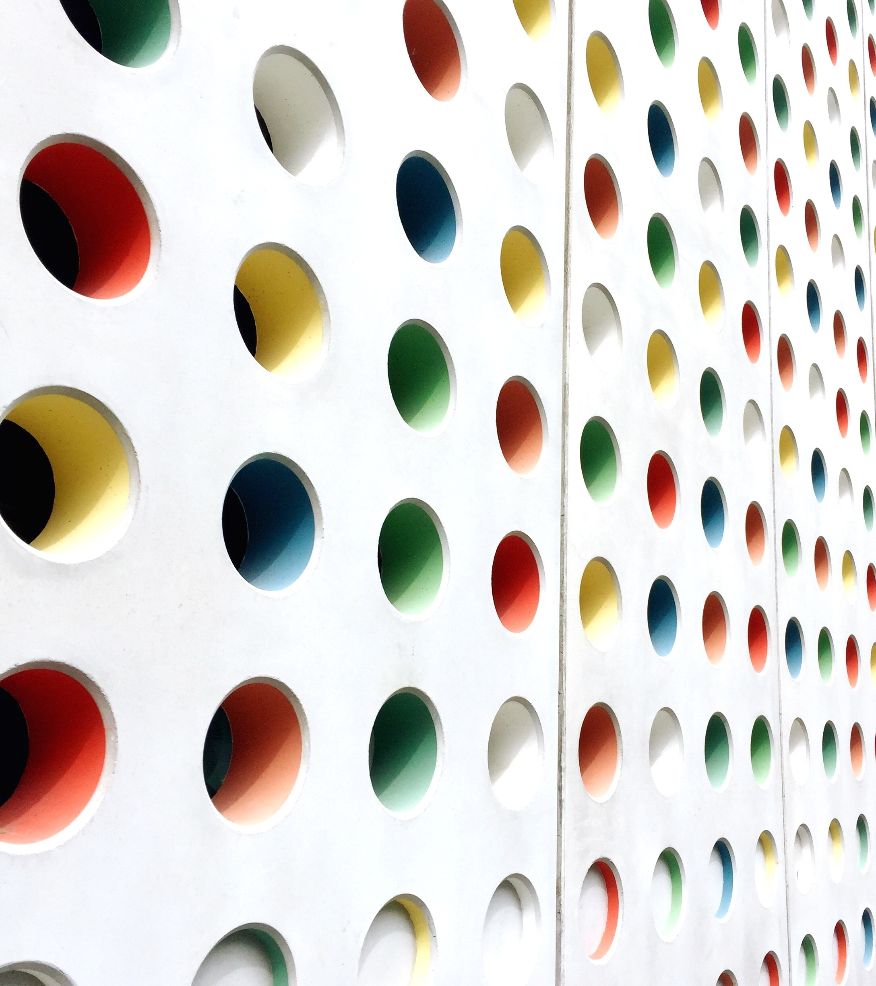
Southern California Fashion Capitol of the WORLD
PATRICK MONTAGNE

Slide 2
Movies
Anything Goes
Population
Discretionary Income
Weather
Cotton
Build A Brand
Samples

Slide 3
What is Fashion?
In addition to clothing, jewelry and hats,
fashion also means hair-styles, attitudes,
speaking style, walking style, hair, and
overall personality.

Slide 4
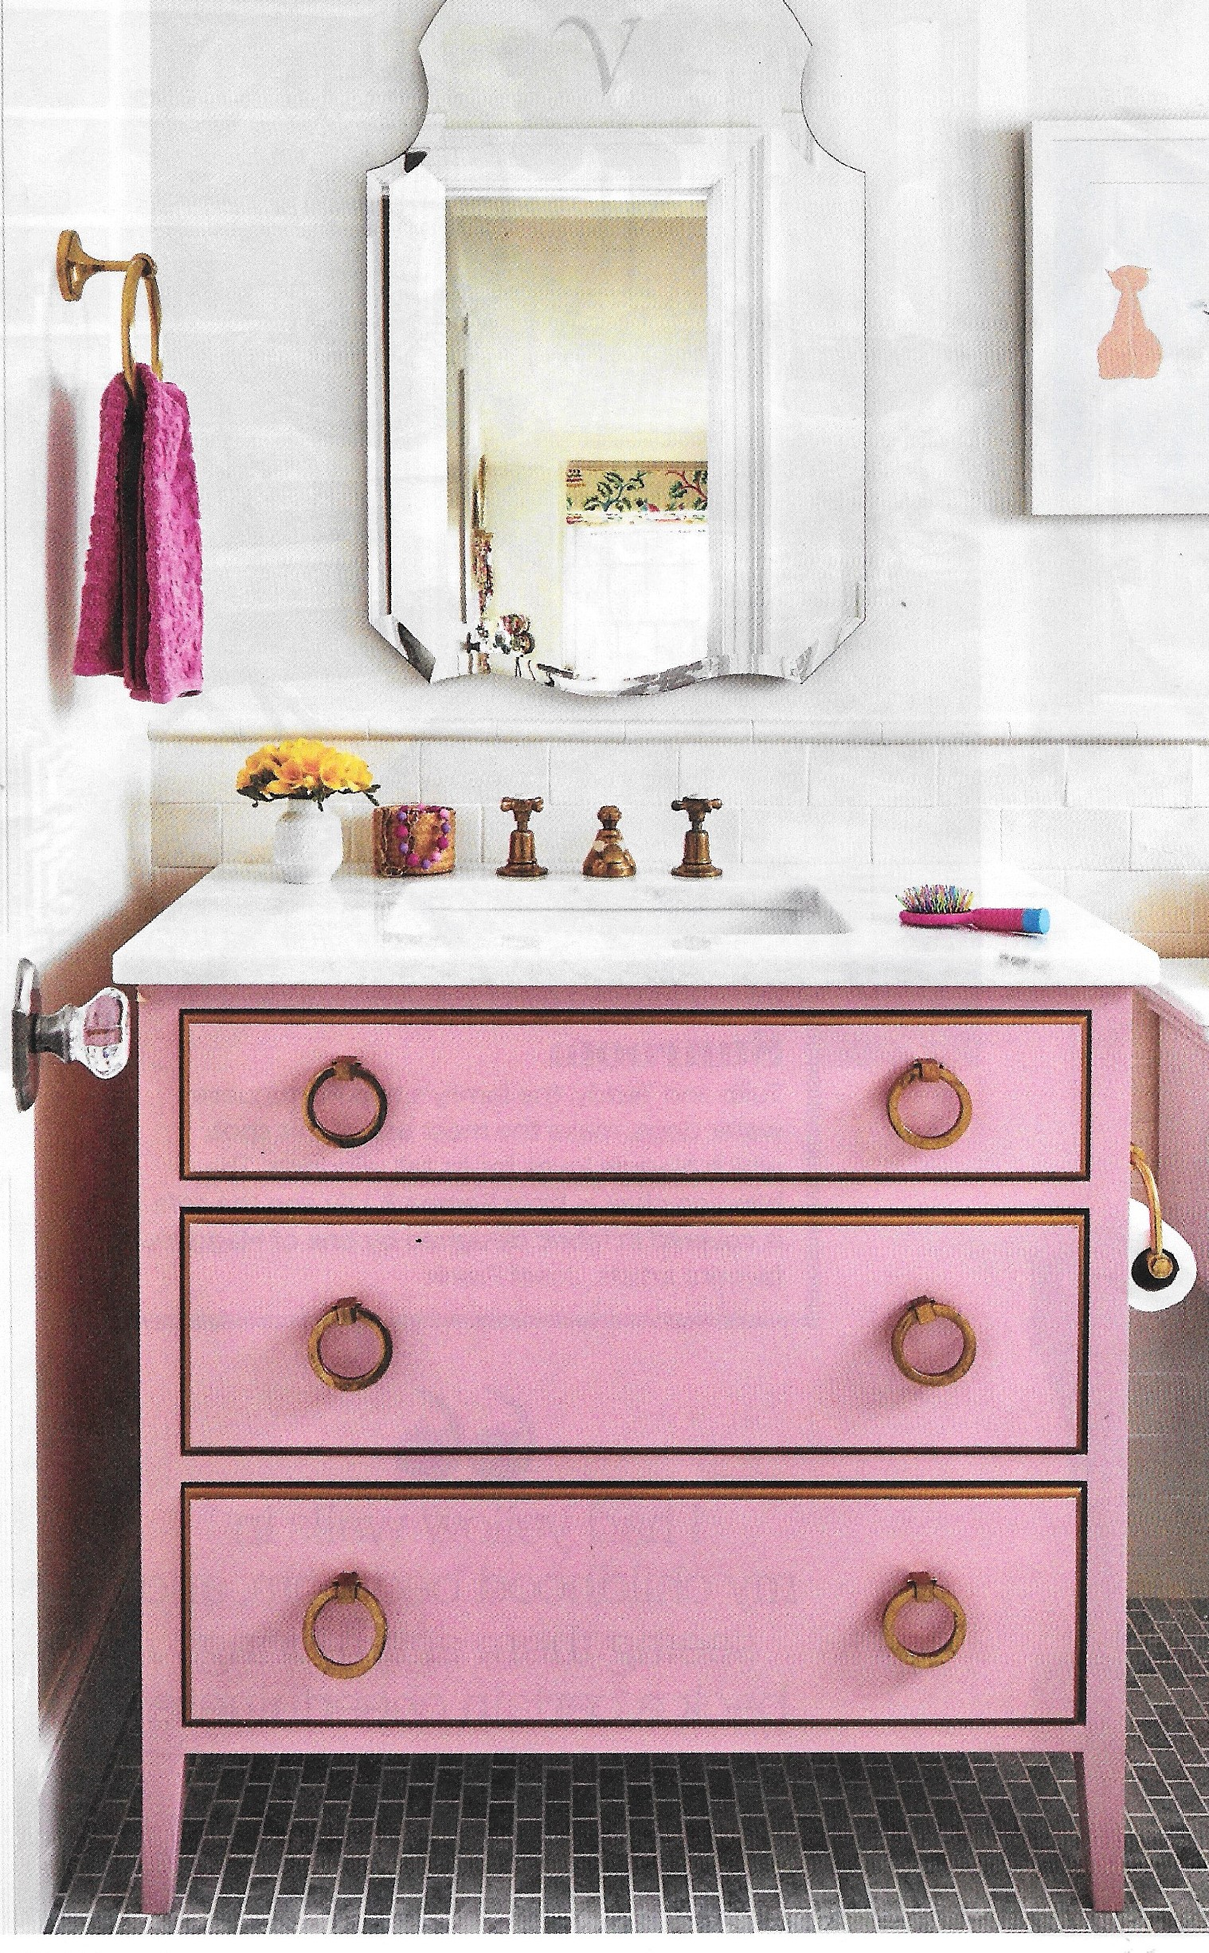
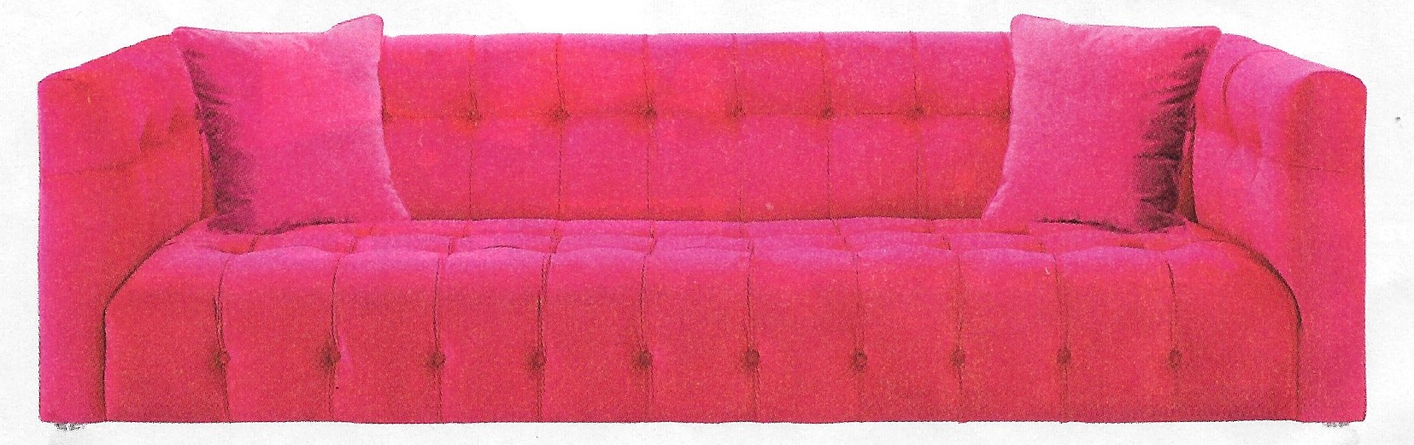
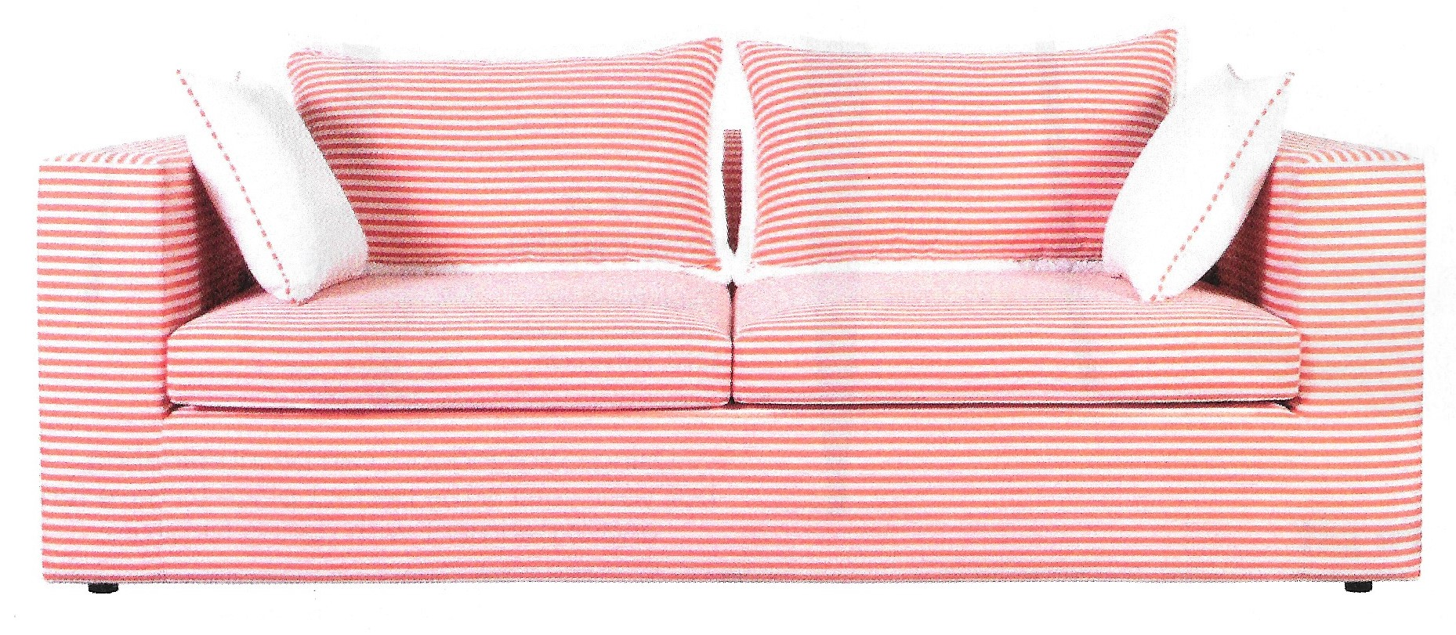
Movies & Television

Slide 5
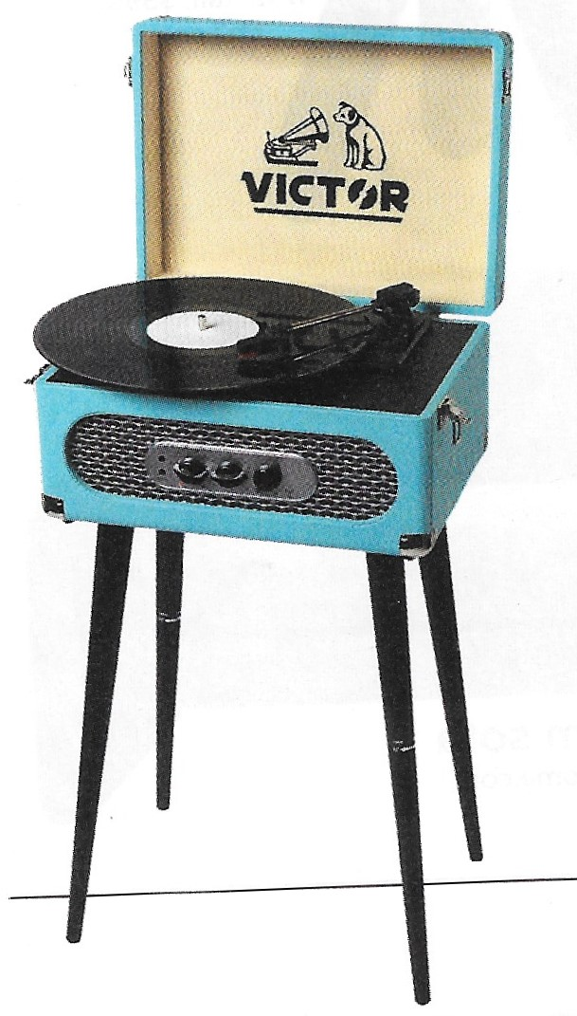

Slide 6
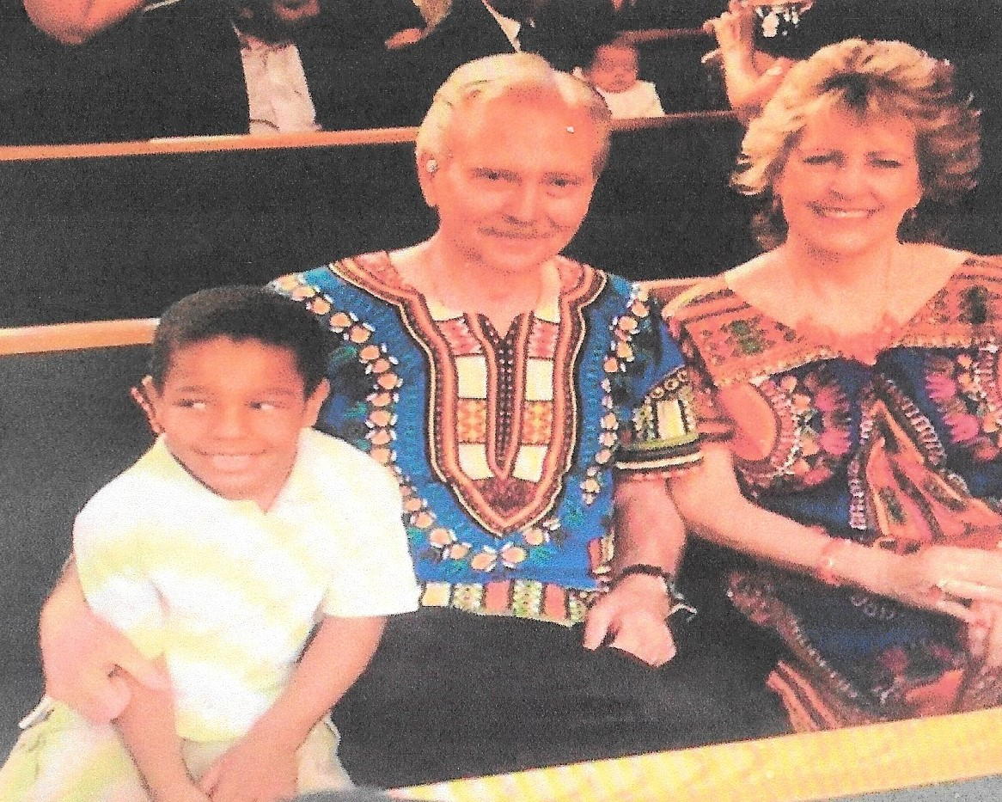
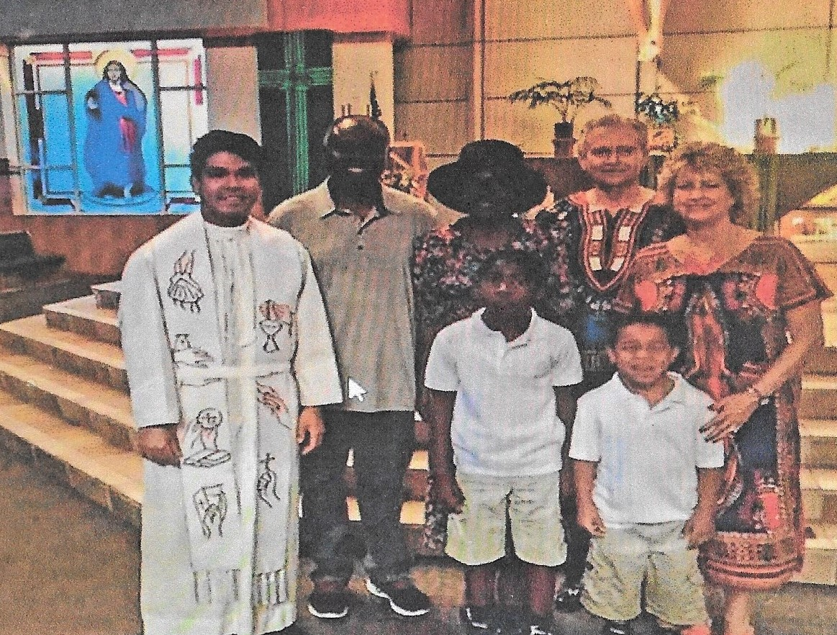
Anything Goes - Diversity

Slide 7
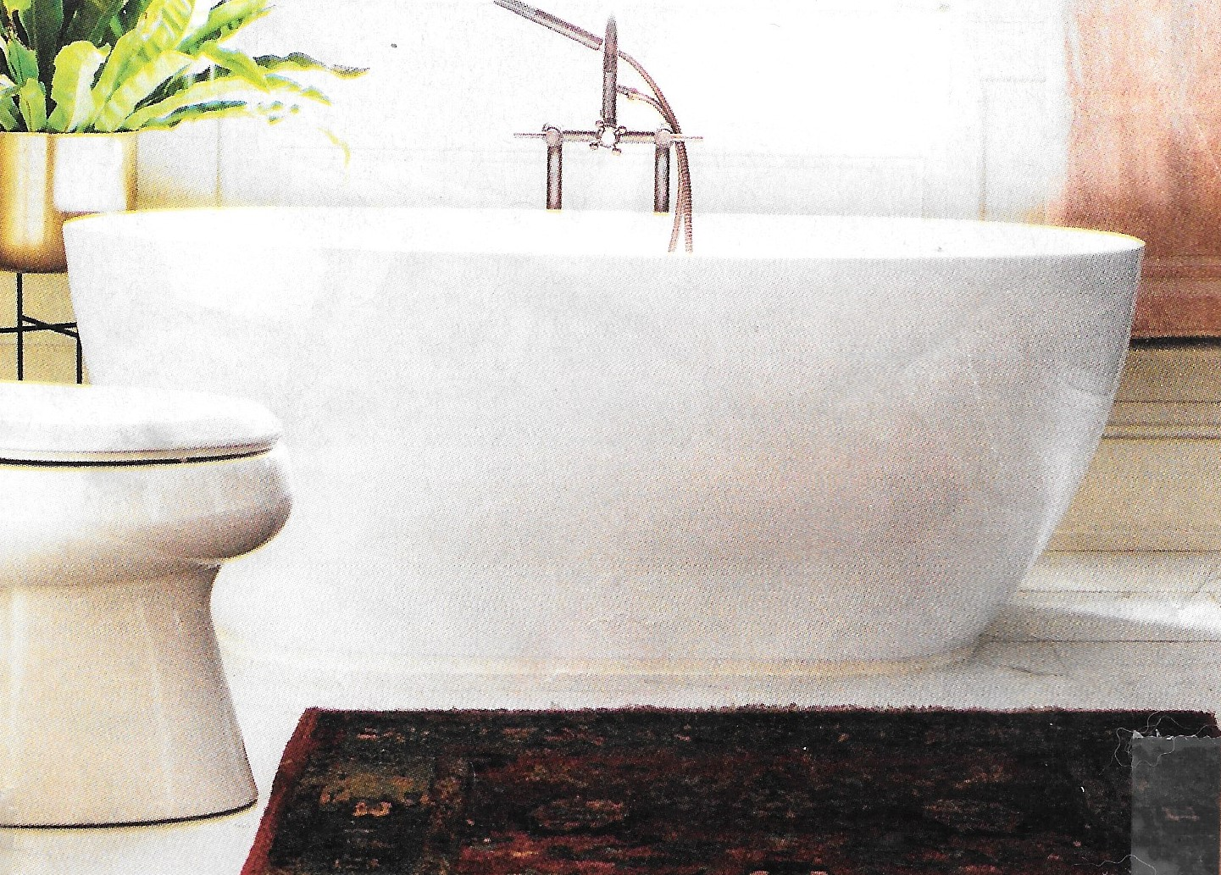
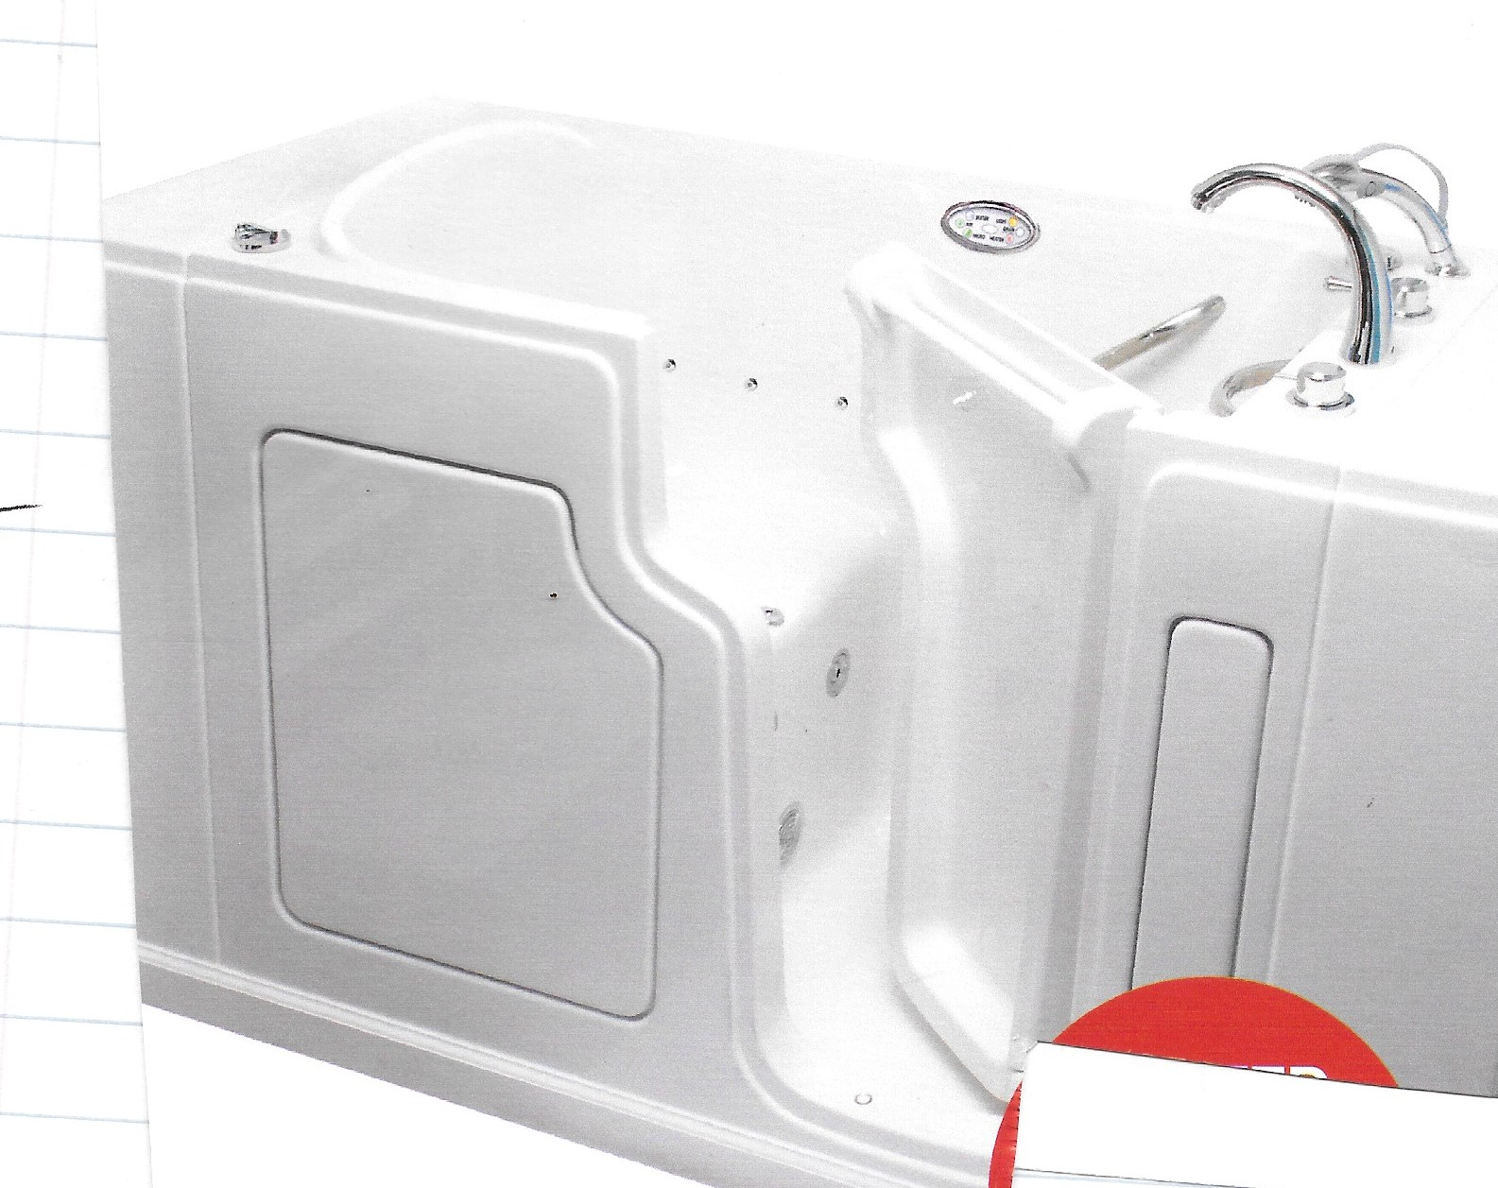


Slide 8
Population
Compressed, 100 miles from
where we are standing

Slide 9
Discretionary Income
I see it I buy it (Credit Cards)

Slide 10
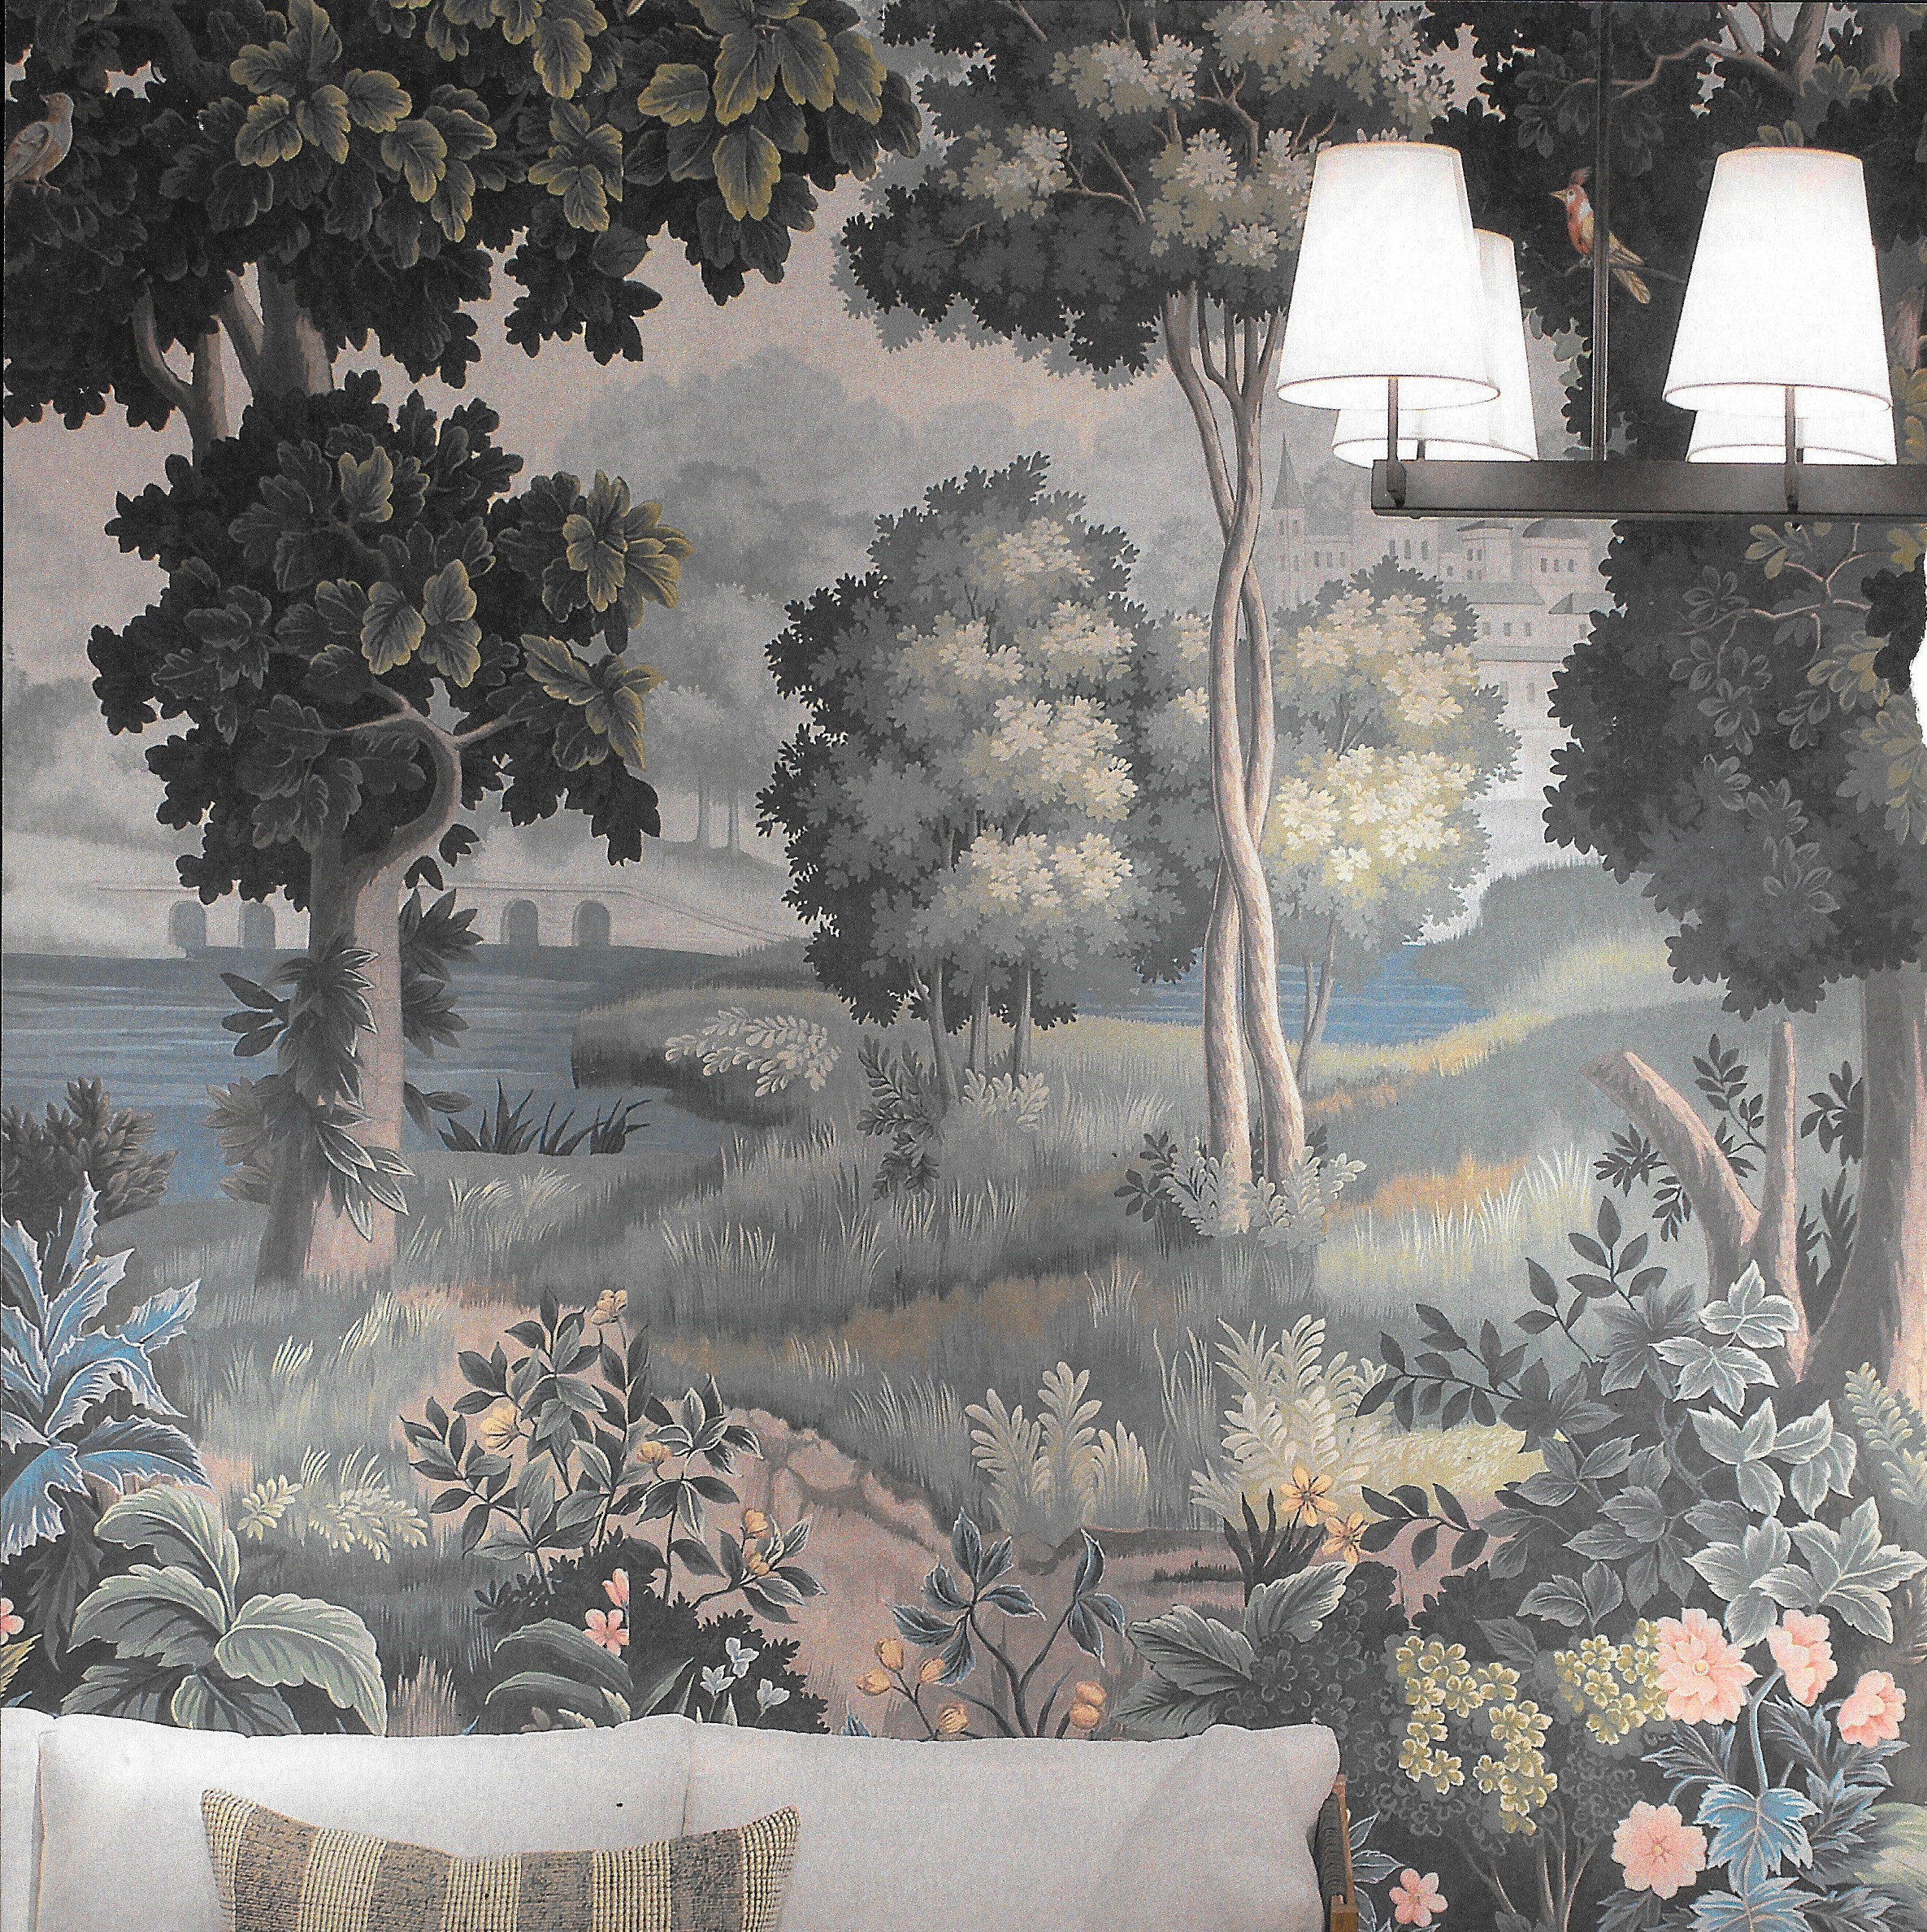
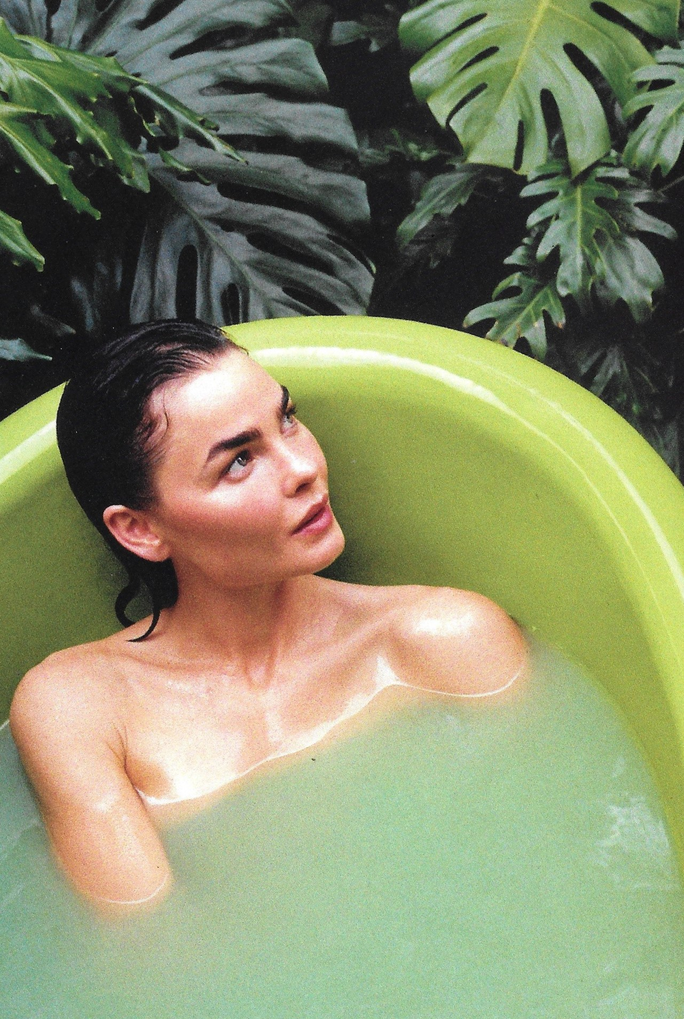

Slide 11
Weather

Slide 12
Cotton – Within 100 miles

Slide 13
Build a Brand
That equals fashion

Slide 14
Samples
The coming fashion for Men
and Women

Slide 15
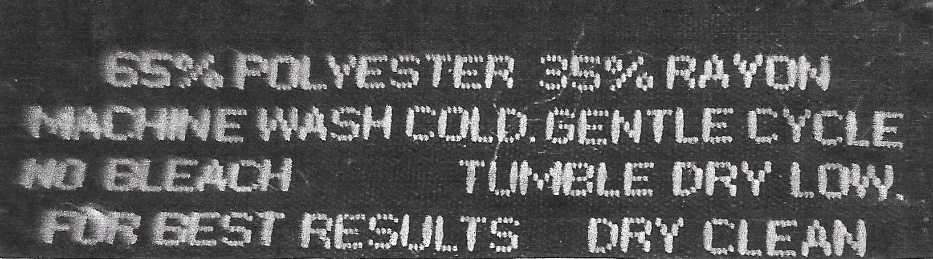

Slide 16
